Slide 1

[Samsung PRISM] Mid Review Report
[5G MAC control decoders]
Team
College Professor(s): S.Kayalvizhi, Dr. K. Ferents Koni Jiavana
Students:
RESHESH KUMAR PATHAK
KAUSTUV MOHANTY
KINJALK SRIVASTAVA
SUKRATI MADARIYA
Department: ECE
Date: 12 July 2022

Slide 2
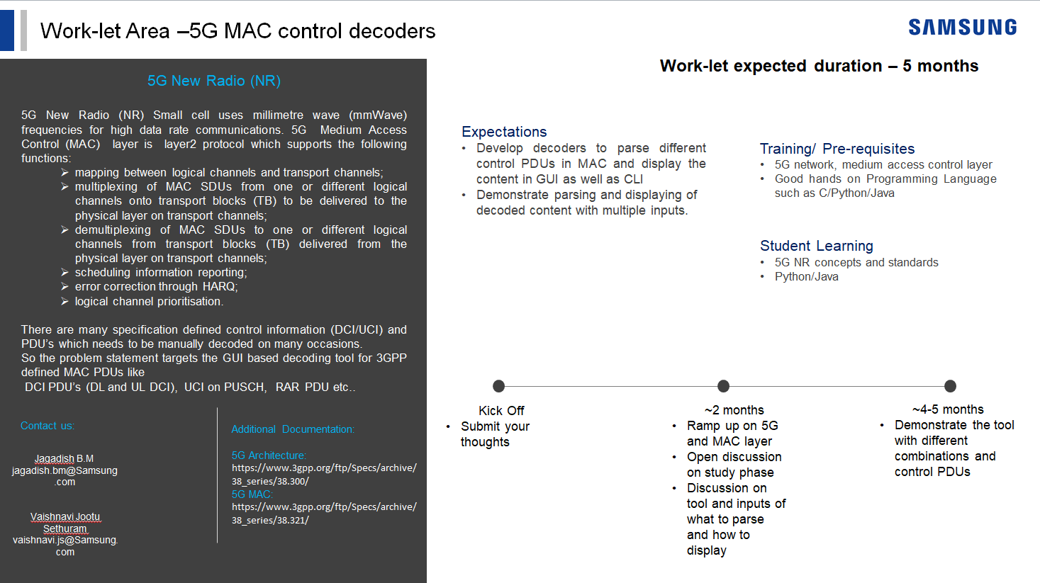
Notes:
-

Slide 3
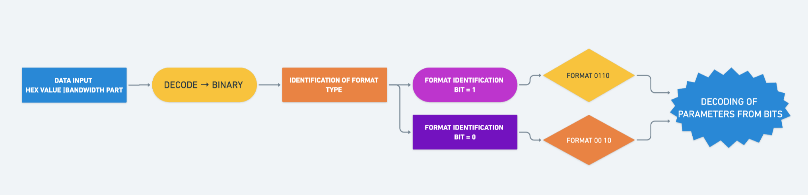
Proposed Approach / Solution
Concept Diagram :
( Clear detailed schematic / block diagram / flow chart depicting the proposed concept / solution )

Slide 4
Dataset(s) Analysis / Description
Dataset Capture / Preparation / Generation :
(Discuss the dataset generation process or if downloaded data provide details of what data & from where it was obtained etc… - 2 to 3 bullets only)
Get hexadecimal values and bandwidth from user
Convert the hexadecimal value into binary.
Flip the sequence of the binary value and decode.
Dataset Understanding / Analysis :
(Provide 2 to 3 bullets about what is your understanding of the data / opinion about the data)
Data provided has to be converted into binary
The parameters of the DCI formats has to be decoded from the binary values using specific bit lengths
Get the output values of each parameters as per bit lengths.
Dataset Pre-Processing / Related Challenges (if any) :
(List out the challenges you fore see in data handling wrt problem definition – 2 to 3 bullets only)
Many parameters required / had dependency on higher RRC layers
Conversion of hexadecimal to binary and reading of bit order
Conversion of bandwidth to RB to calculate parameters

Slide 5
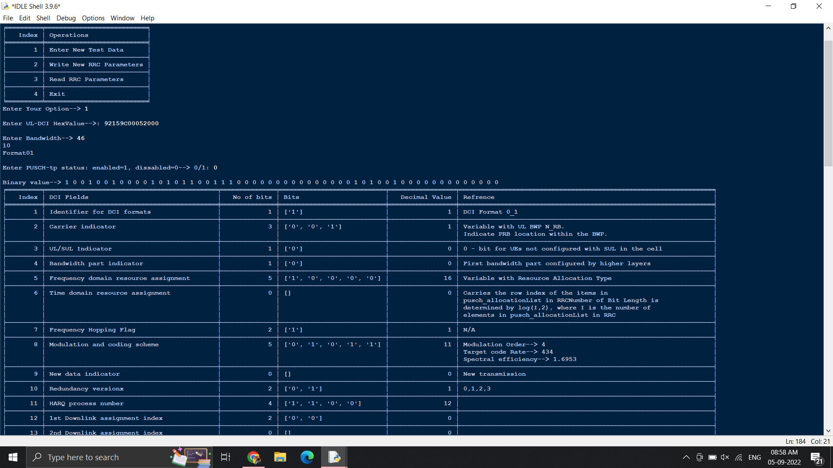
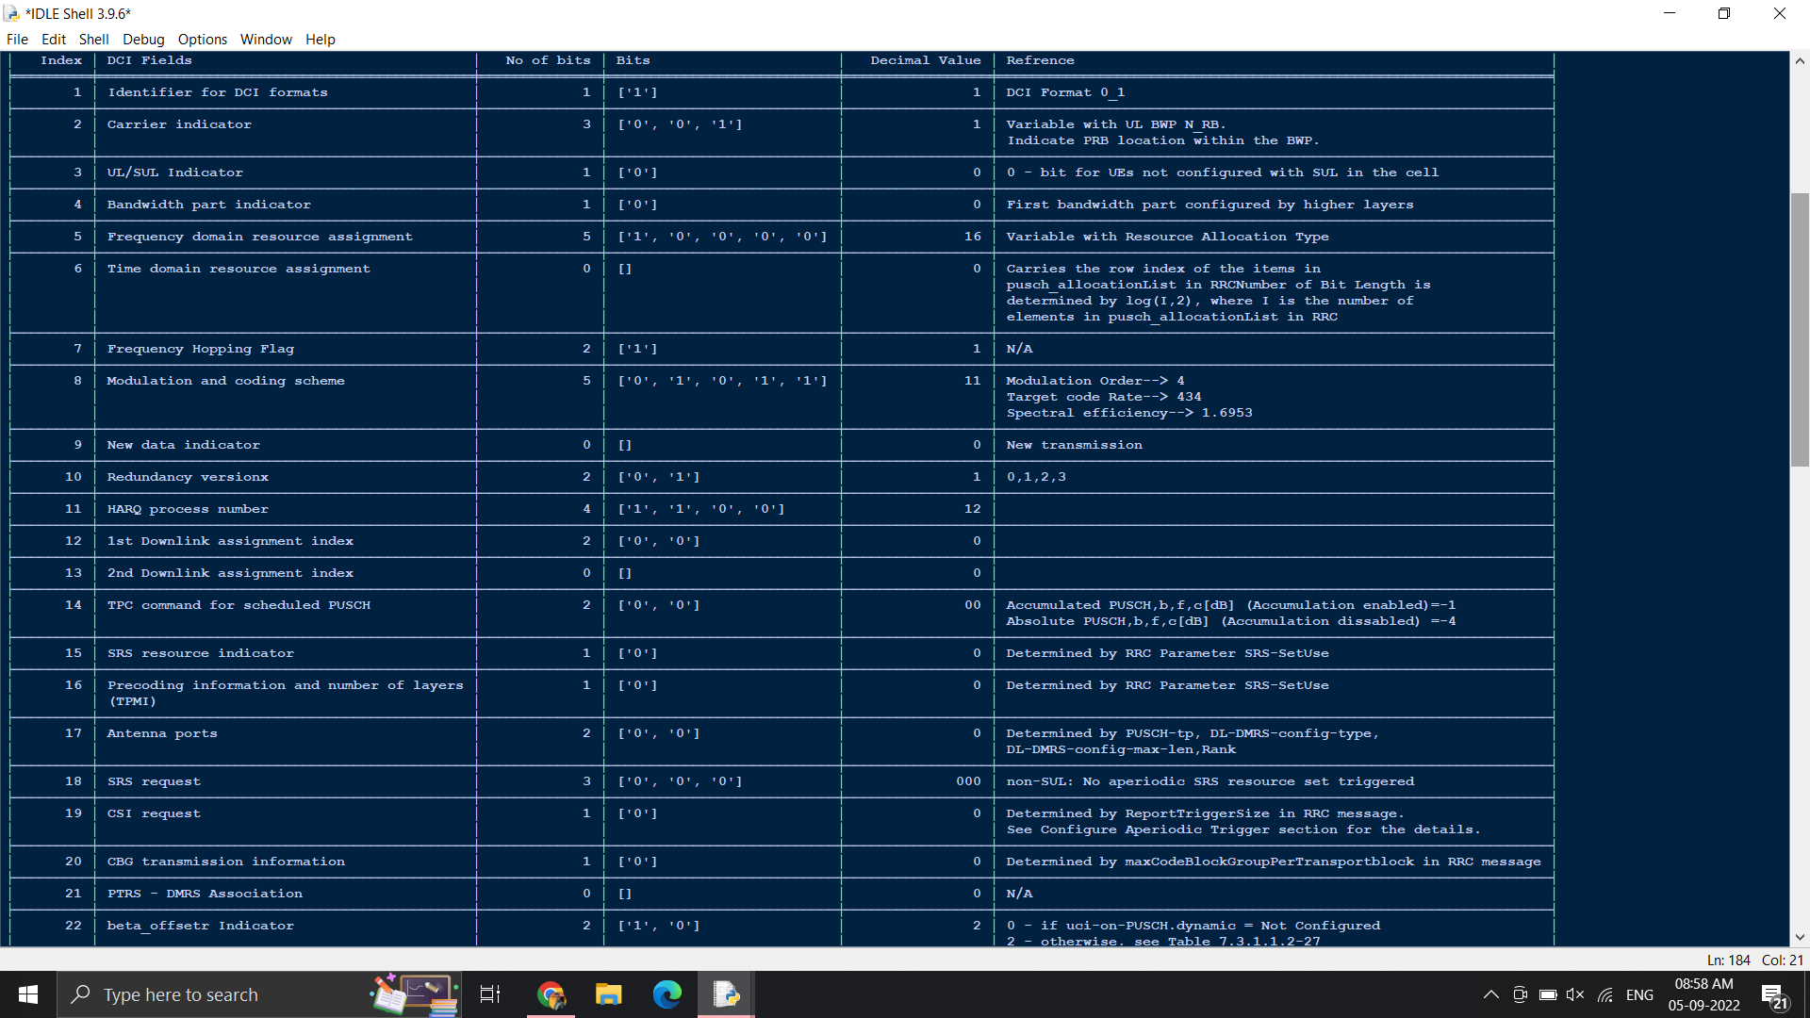
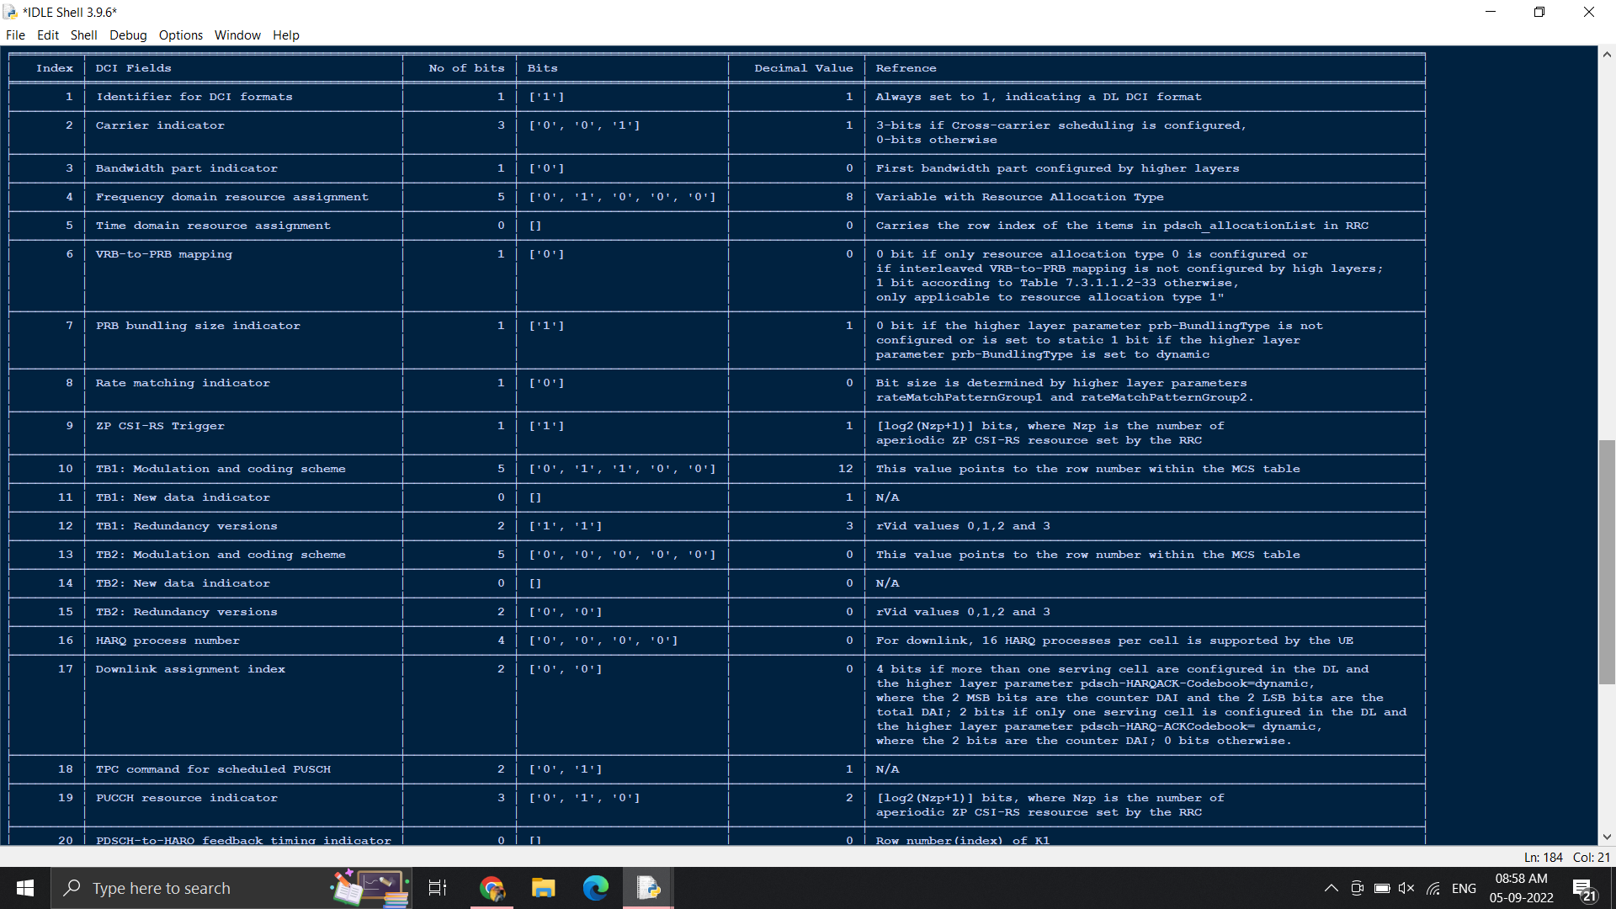
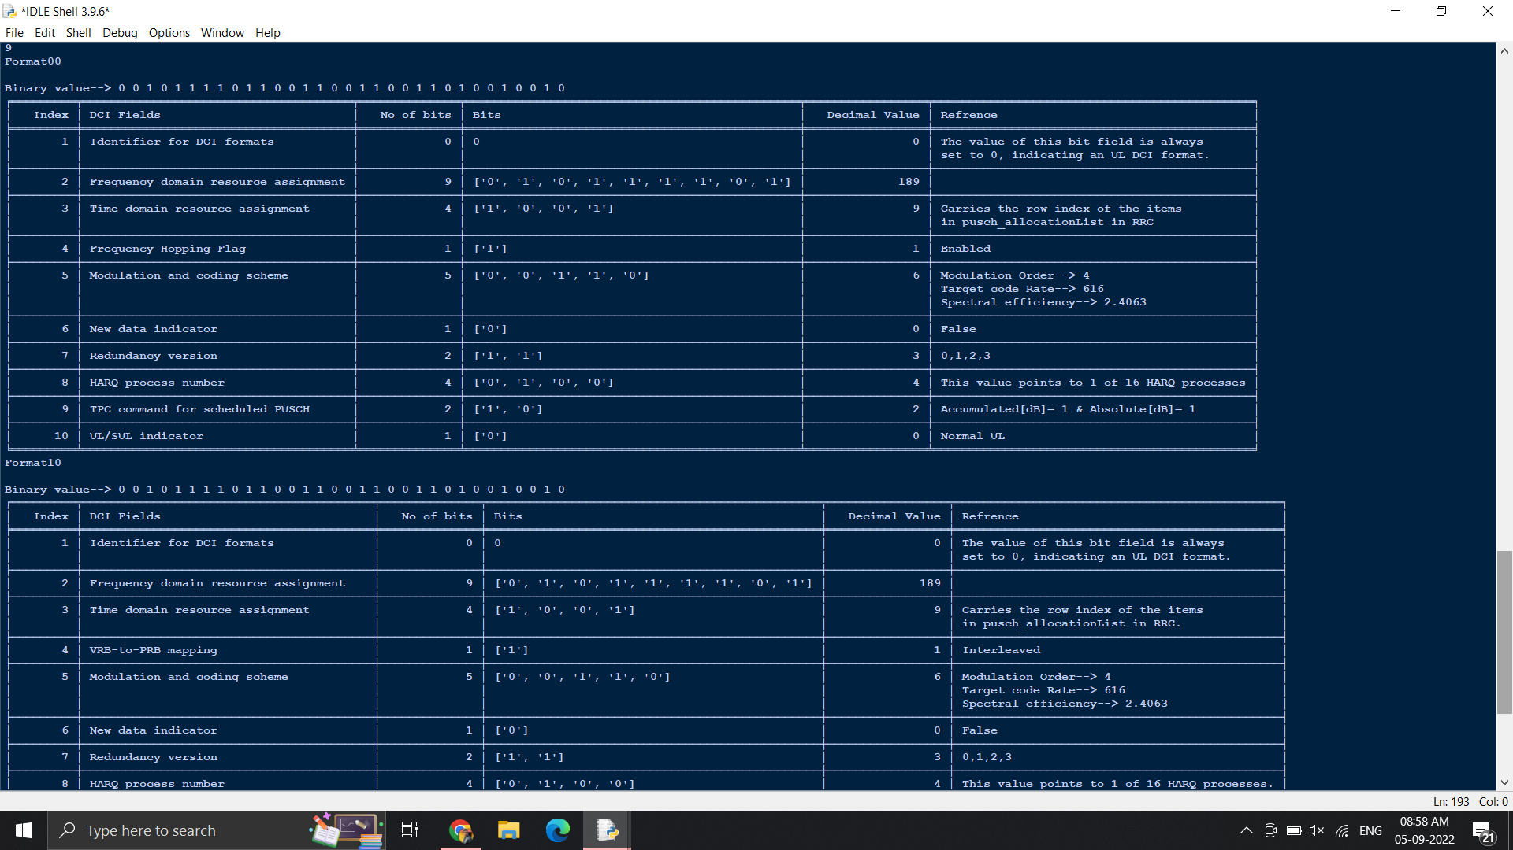
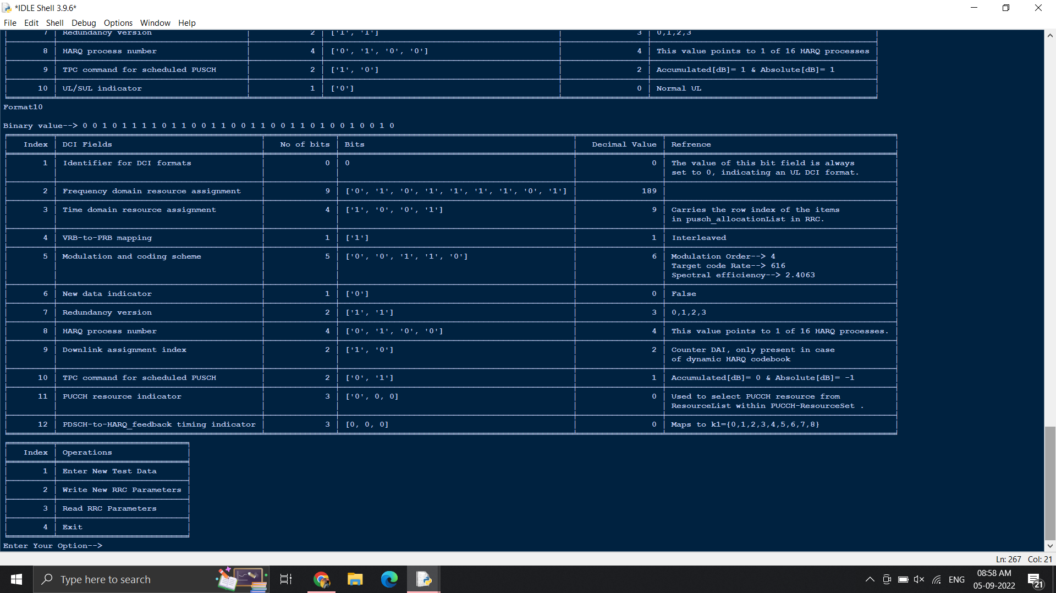
Experimental Results / Simulations / Observations
Results :
(provide numerical data / bar charts / plots / images / videos / tabulated results etc. Use full slide or multiple slides up to max 3 slides to demonstrate the results)

Slide 6
Further Plan to Complete Project
Final Probable Deliverables :
(Discuss in the form of bullets, what are the next steps to complete the solution, any road blocks / bottlenecks, any support needed from SRIB)
Possible solutions include :
Making the code dynamic to accept variable bit lengths
Making changes suggested in the last review meeting
Any challenges :
We didn't have the availability of the sourcing of an appropriate data set to complete the final task
Support needed :
Proper data set
Decoded formats to check the accuracy of our solution

Slide 7
Further Plan to Complete Project
Completion Plan:
(High level plan to complete the project in next 8 weeks after review, in format below)
Week 1 to 2
Step 1 : get to know about the title.
Step 2 : collect information related to topic.
Week 2 to 4
Step 1 : get theoretical knowledge about MAC layer
Step 2 : search for the sample decoders
Week 5 to 6
Step 1: start to make pseudo code
Step 2 : start working on formate 0_0 code
Week 7 to 8
Step 1: start working on formate 1_0 code
Step 2 : start working on formate 0_1 and 1_1 code
Challenges Anticipated:
Certain team mates knew the code in python & Java that needed to be decoded to provide the final approach of the project
Git Upload details: https://github.ecodesamsung.com/SRIB-PRISM/SRM_AN15SRM_5G_MAC_control_decoders

Slide 8
Thank you

